Slide 1
Introduction to Web Mining

Slide 2
What is Web Mining?
The process of applying data mining techniques to extract useful information from Web data.
It can be broadly classified into 3 categories:
Web Content Mining: It is responsible for exploring proper and relevant information from the contents of web pages.
Web Structure Mining: It is used to find out the relation between different web pages by processing the structure of web. The structure of a typical Web graph consists of Web pages as nodes, and hyperlinks as edges connecting two related pages.
Hyperlinks provide structural information which, coupled with Web content, can be used to mine useful information from the Web and to measure the quality of information.
Web Usage Mining: It is the application of data mining techniques to discover interesting usage patterns from Web data.
It is responsible for recording the user profile and user behaviour inside the log file of the web.

Slide 3
Ranking Algorithms
They are used to rank the search results depending upon their relevance to the search query.
They are of two types: Text based ranking & Link based ranking
Link-Based Ranking Algorithms
They view the web as a directed graph where the web pages form the nodes and the hyperlinks between the web pages form the directed edges between these nodes.
HITS (Hypertext Induced Topic Search) Algorithm
It is a search query dependent algorithm that ranks the web page by processing its entire in links and out links.
It is based on the concept of Authority and Hub.

Slide 4
Authority: It is a page that provides important/trustworthy information.
Hub: It is a page that provides links to Authority pages.
They exhibit a mutually reinforcing relationship: a good Hub points to many good Authority pages and a good Authority is pointed by many good Hub pages.
Basic steps of the algorithm:
Fetch a root set of web pages from a search engine
Expand the root set to get base set of web pages
Initialize authority and hub values of all the pages to 1
For each page update authority value as
New authority = sum of hub values of all the pages pointing to it
For each page update hub value as
New hub = sum of authority values of all the pages it is pointing to
Normalize authority and hub values (dividing each value by the square root of the sum of the squares of all authority/hub values)
Repeat steps 4 to 6 until converge

Slide 5
B
Initialize Authority & Hub to 1
Web page | Authority | Hub
A | 1 | 1
B | 1 | 1
C | 1 | 1
D | 1 | 1
E | 1 | 1
Update Authority & Hub
Web page | Authority | Hub
A | 1 | 3
B | 2 | 0
C | 0 | 3
D | 3 | 0
E | 2 | 2
SS | 18 | 22
Norm | 4.24 | 4.69
A
Normalize Authority & Hub
Web page | Authority | Hub
A | 0.236 | 0.64
B | 0.472 | 0
C | 0 | 0.64
D | 0.708 | 0
E | 0.472 | 0.426
E
C
D
Update Authority & Hub
Web page | Authority | Hub
A | 0.64 | 1.652
B | 1.066 | 0
C | 0 | 1.416
D | 1.706 | 0
E | 1.28 | 1.18
SS | 6.095 | 6.127
Norm | 2.469 | 2.475
Update Authority & Hub
Web page | Authority | Hub
A | 0.572 | 1.641
B | 1.144 | 0
C | 0 | 1.468
D | 1.716 | 0
E | 1.239 | 1.123
SS | 6.116 | 6.109
Norm | 2.472 | 2.472
Normalize Authority & Hub
Web page | Authority | Hub
A | 0.259 | 0.667
B | 0.432 | 0
C | 0 | 0.572
D | 0.691 | 0
E | 0.518 | 0.477
Normalize Authority & Hub
Web page | Authority | Hub
A | 0.231 | 0.664
B | 0.463 | 0
C | 0 | 0.594
D | 0.694 | 0
E | 0.501 | 0.452

Slide 6
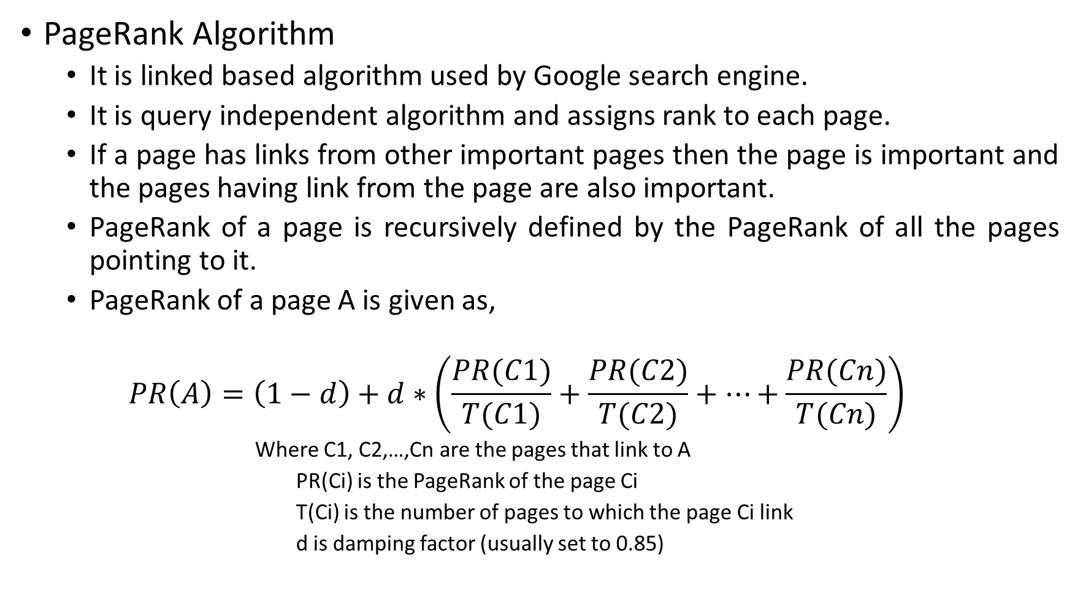
PageRank Algorithm
It is linked based algorithm used by Google search engine.
It is query independent algorithm and assigns rank to each page.
If a page has links from other important pages then the page is important and the pages having link from the page are also important.
PageRank of a page is recursively defined by the PageRank of all the pages pointing to it.
PageRank of a page A is given as,
$$PR\left(A\right)=\left(1−d\right)+d∗\left(\frac{PR(C1)}{T(C1)}+\frac{PR(C2)}{T(C2)}+…+\frac{PR(Cn)}{T(Cn)}\right)$$
Where C1, C2,…,Cn are the pages that link to A
PR(Ci) is the PageRank of the page Ci
T(Ci) is the number of pages to which the page Ci link
d is damping factor (usually set to 0.85)

Slide 7
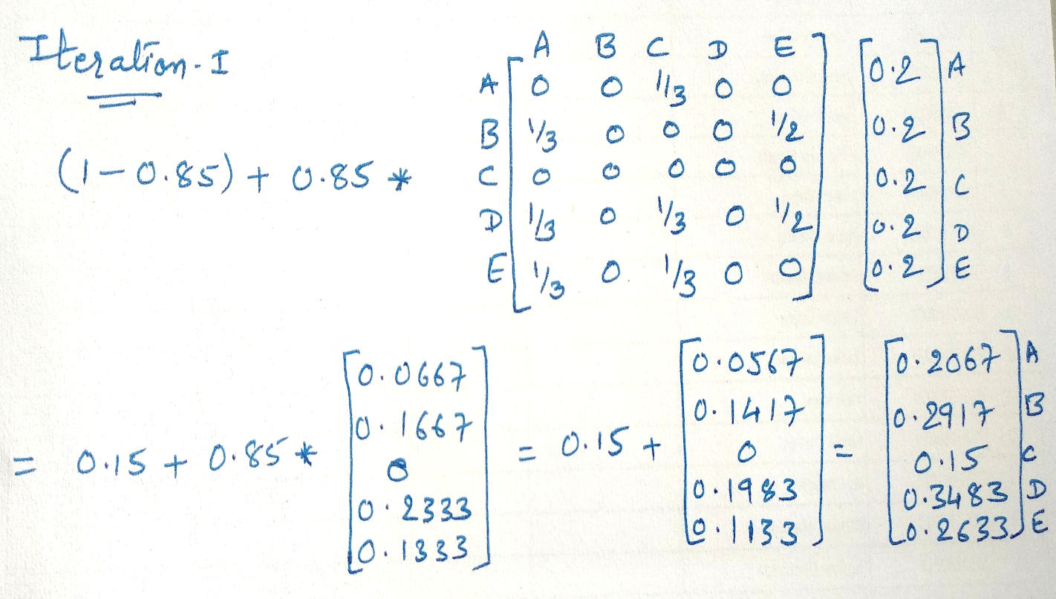
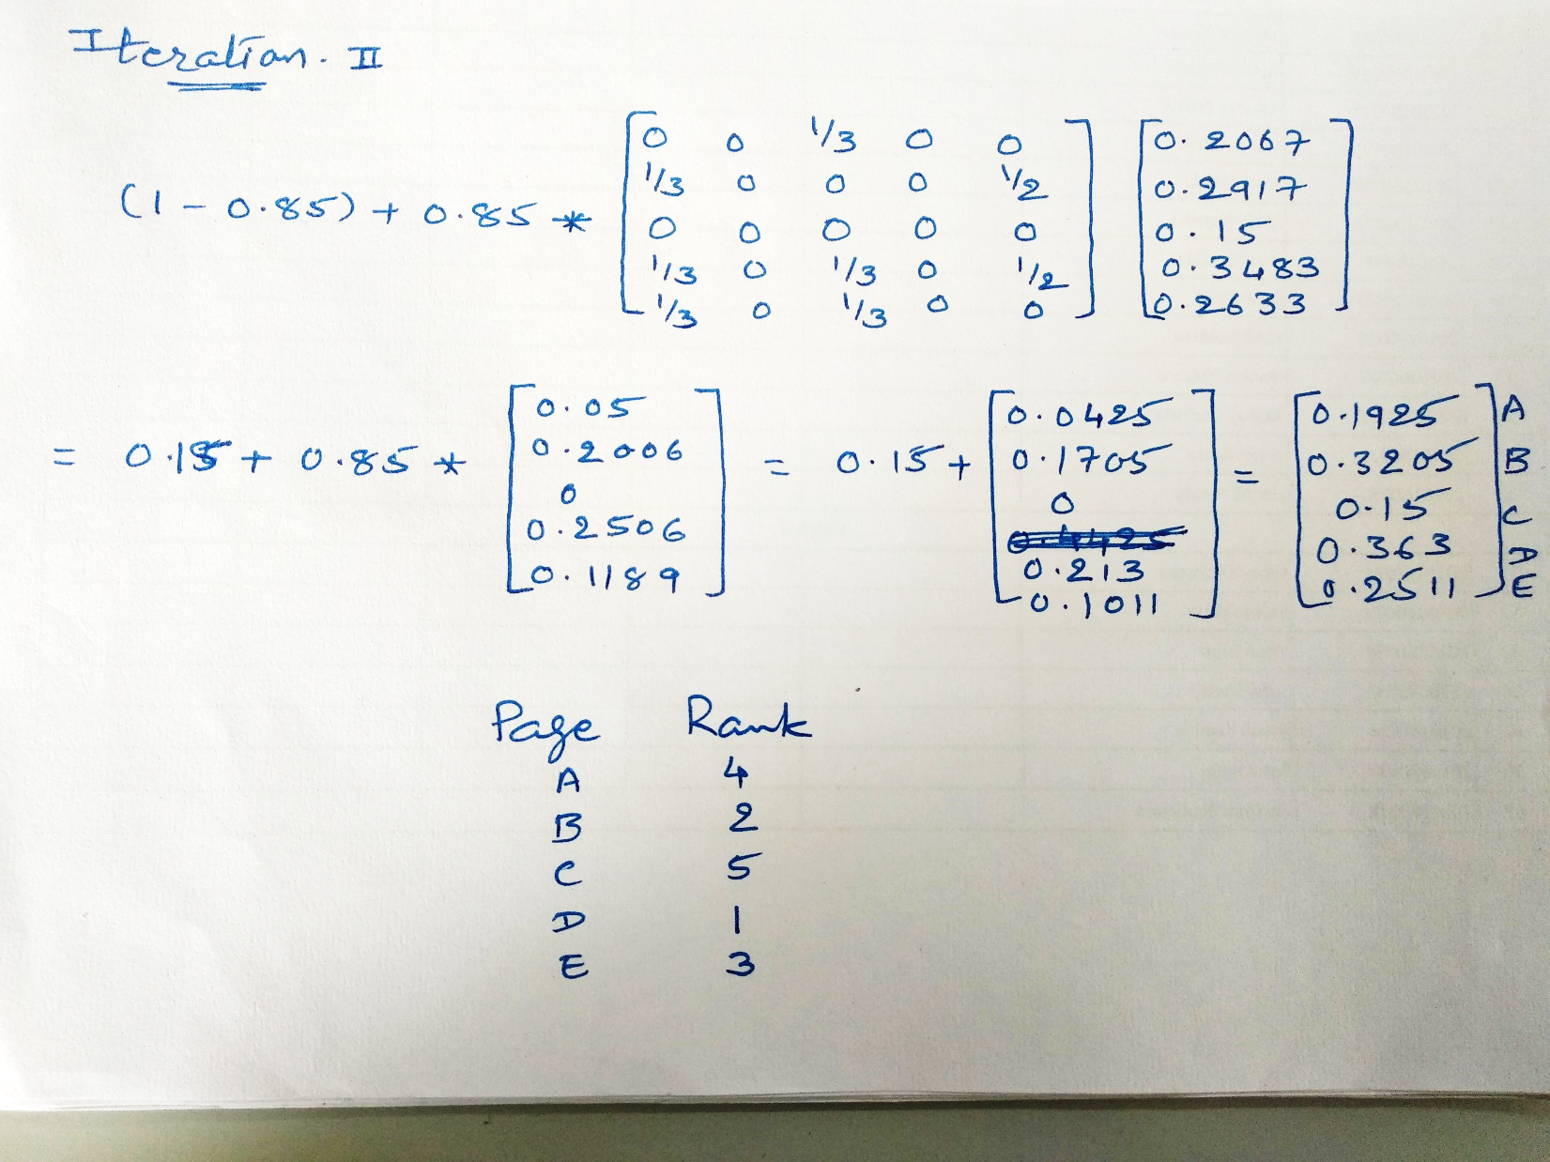
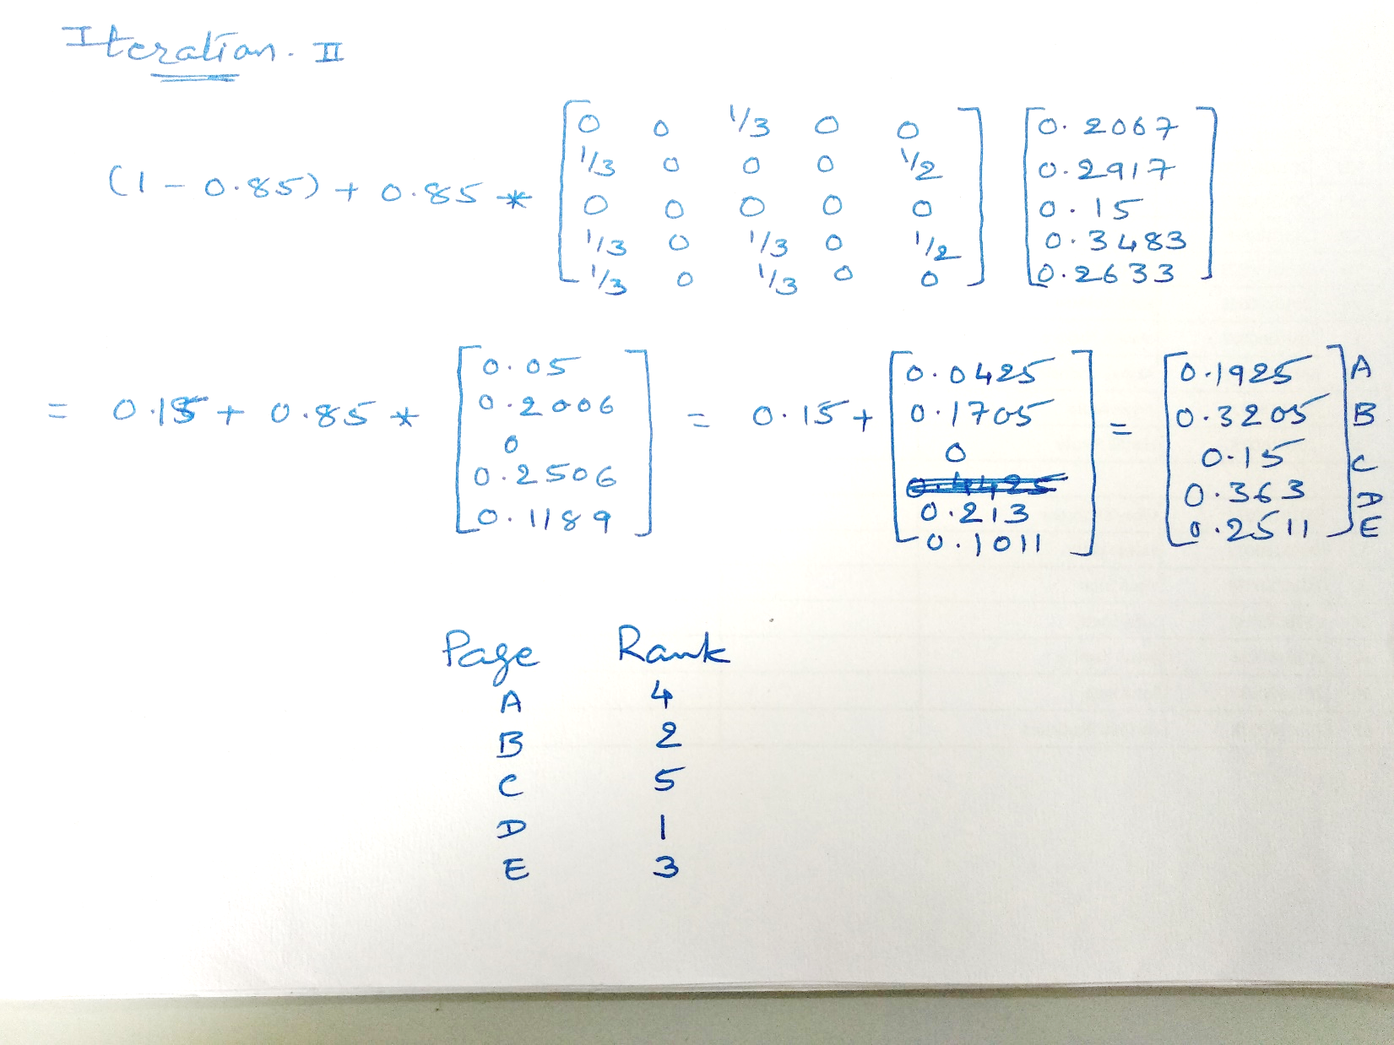
B
A
Initialize PageRank
Web page | PageRank
A | 0.2
B | 0.2
C | 0.2
D | 0.2
E | 0.2
E
C
D

